Slide 1



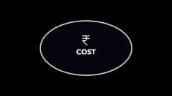









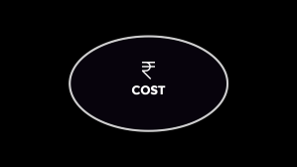





TURF​
BOOKING​
BOOK YOUR TURF NOW!​

Slide 2





APP

Slide 3
APP

Slide 4

DESCRIPTION
DESCRIPTION

Slide 5
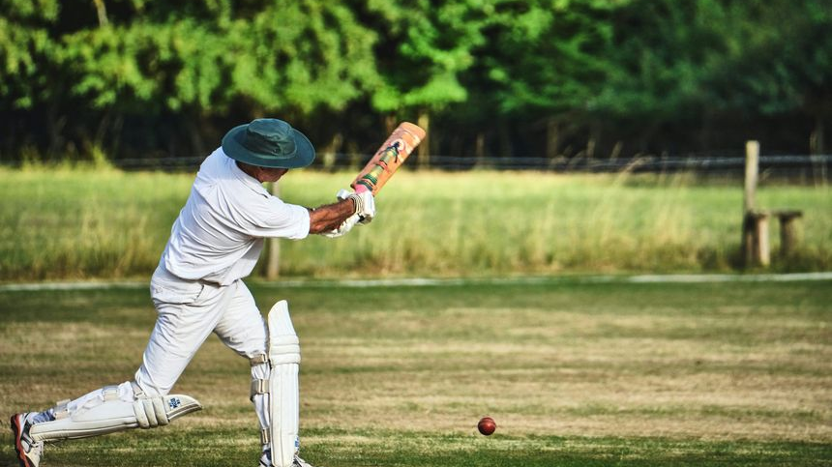
DESCRIPTION
Turf Booking is your ultimate sports ground booking app, designed to make booking turfs, courts, and sports venues easier than ever. Whether you're planning a football match, cricket game, tennis, or any other outdoor activity.
Turf Booking : lets you explore nearby venues and book instantly.

Slide 6

TARGET AUDIENCE

Slide 7

TARGET AUDIENCE
Event Organizers
College And School
Sports Enthusiasts
Corporate Teams

Slide 8

ADVANTAGES
ADVANTAGES

Slide 9

ADVANTAGES
FOR USER (PLAYER)
FOR OWNER (MANAGER)
Time-Saving
Reduced Overcrowding
Convenience
Special Offers and Discounts
General Chat
Efficient Resource Management
Marketing Opportunities
Flexible Pricing Strategies
Scalability

Slide 10

DISADVANTAGES/ LIMITATION

Slide 11

DISADVANTAGES
/ LIMITATION
User Reviews and Ratings​
Limited Availability​
Geographic Restrictions​
Technical Glitches​

Slide 12

MAINTENANCE

Slide 13

MAINTENANCE
Regular Updates
User Feedback
Help Center
Marketing & User Engagement
Events and Webinars
Push Notifications

Slide 14

COST

Slide 15


COST
Payment Integration
Basic Notification
User Registration
Booking System
Estimated Total Cost
Estimated Cost : around 25 Lakhs
Real-Time updates
User Review and ratings
Push notifications
Around 80-85 Lakhs
Estimated Cost : 30-35 Lakhs
Development Platform (iOS / Android)
Estimated Cost : 21.5 Lakh
Third Party Integration
Estimated Cost : around 7 Lakhs
Annual Cost (Updates & Maintenance) : 15-20% of initial development

Slide 16

WEBPAGE

Slide 17
http://127.0.0.1:5500/index.html
WEBPAGE

Slide 18

Project Made BY

Slide 19
Project Made BY
Param Chotaliya B23CSE004 202302626010084
Devarsh Shukla B23CSE075 202302626010153
THANK YOU

